Slide 1
Competition Law’s Controversy With Disruption
“Meet to Compete – Repeat”
ICC Croatia Competition Commission, May 14, 2026
Herbert Hovenkamp

Slide 2
Disruption: a Principal Driver of Innovation Has Competition Policy Been Unreasonably Hostile?
1. Progressive Era (1890-1920+): Technology & large firms: e.g., Standard Oil, American Can, U.S. Steel, International Harvester: dominance (monopoly) vs. productivity (lower costs and prices)
2. Retail Distribution Revolution: Scale, Scope, and Vertical Integration in Competitively Structured Markets (1920-1960)
3. The Digital Revolution: IBM (1960s-1980s)
4. The Tech Network Revolution; DMA; AICOA (1990s -): the same errors, Repeated?

Slide 3
Disruption I: Emergence of the Large Firm (1890-1920)
19th Century State Law Limited Corporate Power
Productive assets confined to single state
No holding companies
Narrow Business Purpose Clauses
Common law “Trusts” were (legally unsuccessful) efforts to get around these
New Jersey – amended corporate law to reject all three.
Ohio v. Standard Oil (1892) condemned Standard Trust under state corporate law
Standard reincorporated under New Jersey law
Progressives saw NJ as “Traitor State”
In fact, NJ facilitated the modern national/international corporation, increasing economic growth significantly
Antitrust law addressed monopoly through “Restraint of Trade” (“high output”) approach instead of “small corporations”

Slide 4
Progressive Era & Antitrust Goals: Small Firms v. High Output?
Chief Justice White (Standard Oil, 1911):
“The evils which led to the public outcry against monopolies and to the final denial of the power to make them may be thus summarily stated: (1) The power which the monopoly gave to the one who enjoyed it, to fix the price and thereby injure the public; (2) The power which it engendered of enabling a limitation on production; and (3) The danger of deterioration in quality of the monopolized article which it was deemed was the inevitable resultant of the monopolistic control over its production and sale.”
Standard Oil Co. of New Jersey v. United States, 221 U.S. 1, 52, 55 (1911) (numbers in original)
70 years later would become the “consumer welfare” principle
In contrast to the corporate approach, it favors large firms and also vertical integration.

Slide 5
Disruption II: Anti-Chain Store Movement and Antitrust’s Goals
Historically, most retailers were single store operators served by independent distributors providing warehouses and supply
Then, some retailers began …
Horizontally: opening multiple stores and dealing in larger quantities
Vertically: operating as their own distributors, integrating directly into warehousing, transportation, and supply
Were able to lower costs and offer lower prices
Today, in U.S.: 2/3 of shopping at large chains; less for Europeans

Slide 6
The Rise of Organized Distribution: Responses
1. Boycotts:
Eastern States Lumber (SCT 1914) – retail lumber association boycott of lumber wholesalers who integrated into retailing; illegal per se
Arkansas Wholesale Grocers’ Ass’n v. FTC, 18 F.2d 866 (8th Cir. 1927): same, striking down independent grocers boycott of vertically-integrating stores (illegal per se)
2.“Death Taxes” – progressively higher taxes as a firm owned two or more stores. Liggett Co. v. Lee, 288 U.S. 517 (1933) (striking down Florida statute; J. Brandeis dissented, complaining of corporate bigness.
3. Government-authorized Resale Price Maintenance to prevent discounting (Miller-Tydings Act, 1937; repealed, 1975); unlawful in EU.

Slide 7
4-part Response to Chains, con’t
4. The Robinson-Patman Act (1936)
Sen. Rpt: Clayton Act “too restrictive, in requiring a showing of general injury to competitive conditions.” By contrast, RPA required only “injury to the competitor victimized by the discrimination.”
No inquiry into market power, nor proof of any market impact such as higher prices or reduced output
War on economies of scale: Morton Salt: discounts must be “functionally available” to all buyers (language not in statute)
Already in 1930s, lower income customers, those most harmed by RPA, were heavy chain store users

Slide 8
Competition and the Chains
U.S. Chains were/are large firms but in competitive markets
A&P in 1930: market share about 20%; today, Walmart is about 22% (groceries); groceries: fiercely competitive, with low margins.
Independents are injured even more by chain competition than by chain monopoly
A dominant chain would charge a “limit” price, earning high returns while independent rivals operate as a competitive “fringe”
Under competition, however, the chains drive prices to their own marginal costs, and have some of the lowest margins in the economy

Slide 9
Last Gasp of Anti-Chain Movement: Brown Shoe Merger Decision (1962)
Condemned merger of two manufacturers/retailers (Brown and Kinney); merger was both horizontal and vertical
A “significant aspect of this merger is that it creates a large national chain which is integrated with a manufacturing operation. The retail outlets of integrated companies, by eliminating wholesalers and by increasing the volume of purchases from the manufacturing division of the enterprise, can market their own brands at prices below those of competing independent retailers.” Brown Shoe, 370 U.S. at 344.
Identified as the unlawful “harm” that the merger enabled the firm to offer “lower prices or higher quality for the same price.”
Brown Shoe became poster child for furthering wasteful production and distribution methods in the name of competition.
Supreme Court corrected itself later, finding it “inimical” to antitrust goals to condemn a merger because it preserved competition (Brunswick, 1978) or led to a lower price (Cargill, 1986).

Slide 10
Disruption III: IBM Antitrust Litigation (1969-1982)
Franklin Fisher, et al, Folded, Spindled, and Mutilated: Economic Analysis and U.S. v. IBM (MIT 1983)
U.S. Action (1969), claiming unlawful monopolization; DOJ sought a breakup; voluntarily dismissed in1982
Largest US company by market cap at the time
Two Questions:
1. How much was tech innovation and how much anticompetitive practice?
2. Are the current actions against big tech repeating the same errors?

Slide 11
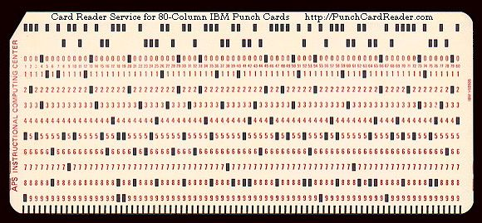
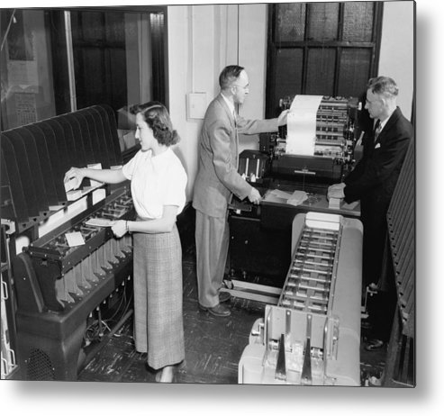
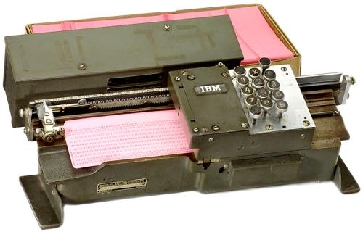
IBM (pre-digital: 1930s & 1940s) U.S. v. IBM (1936) Antitrust: Condemned Tying of Mechanical Culculator to Data Cards
Variable proportion tie, probably
Used for second degree price
Discrimination; IBM had dominant
Market share

Slide 12
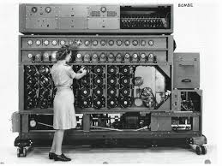
Analog Computation from IBM (1936) to Enigma (World War II)
“The Imitation Game”
Built by British
Tabulating Machine Co.
Electro Mechanical,
not digital

Slide 13
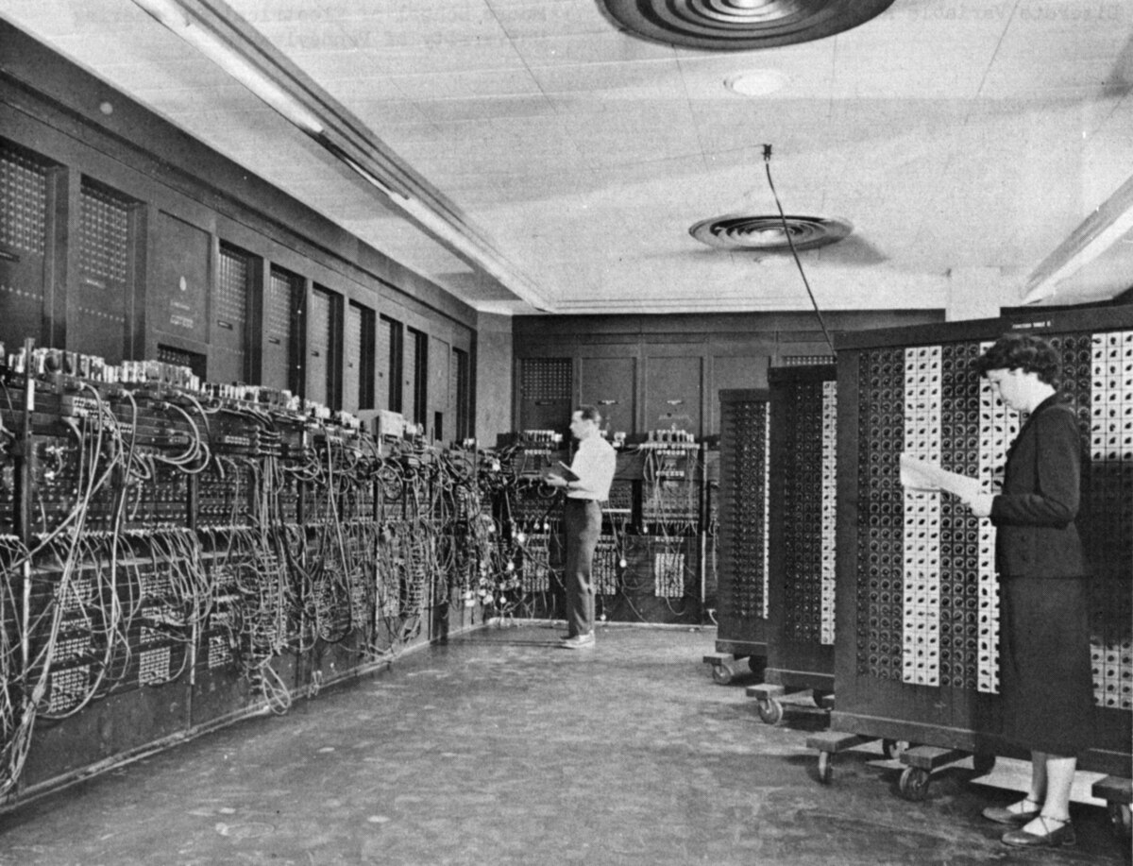
ENIAC (publicly funded, 1945) – first digital processor; military use for calculating weapon trajectories; its speed prompted IBM to go digital

Slide 14

IBM: digitization, miniaturization and consolidation IBM 7090 (1959) (from Dr. Strangelove (1964, Peter Sellers)

Slide 15
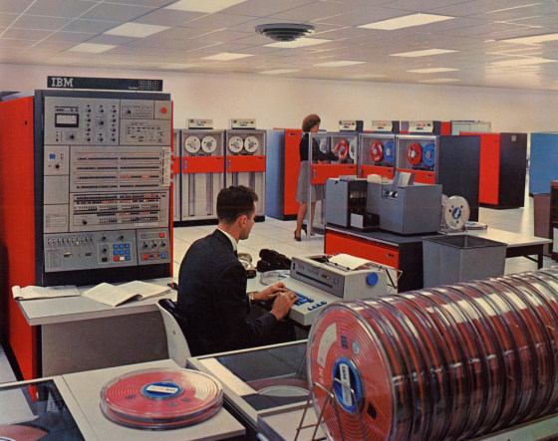
The Revolutionary IBM system/360 (1964+)

Slide 16
United States v. IBM (1969-1982) (response to IBM’s digital advances)
Tying and Bundling – digital technology enabled firms to combine many functions that had previously been performed by separate machines, leading to tying claims
Claim “predatory” product innovation – IBM innovated too rapidly, leaving competitors in the dust
“Vaporware” -- Exaggerated product announcements
“Impact costs” – claim that IBM introduced new product lines when there was still economic life remaining in the existing line (which had been reverse engineered and copied by competitors)
Theory: “lost” revenue from the unmade sales on previous line should be included in the costs of the new line, bringing them below cost.
One of the most anti-innovation theories ever developed. – voluntarily dismissed in 1982.

Slide 17
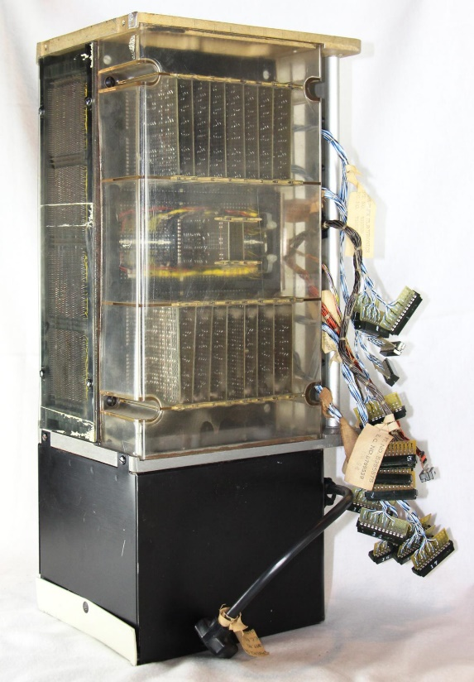
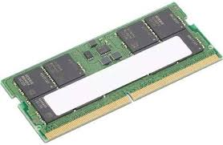
IBM random access digital memory (1965-2026)
Lenovo Thinkpad (IBM successor) RAM, 2025,
capacity 32GB; weight less than one ounce
Capacity ratio from 1965: roughly 250,000 to 1
Weight Ratio: c. 10,000 to 1.
IBM S360 (1965-1978); capacity
128K (single side 5 ¼ inch floppy
Disc=160k, weight 610 pounds

Slide 18
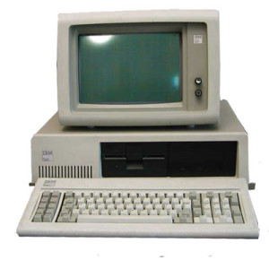
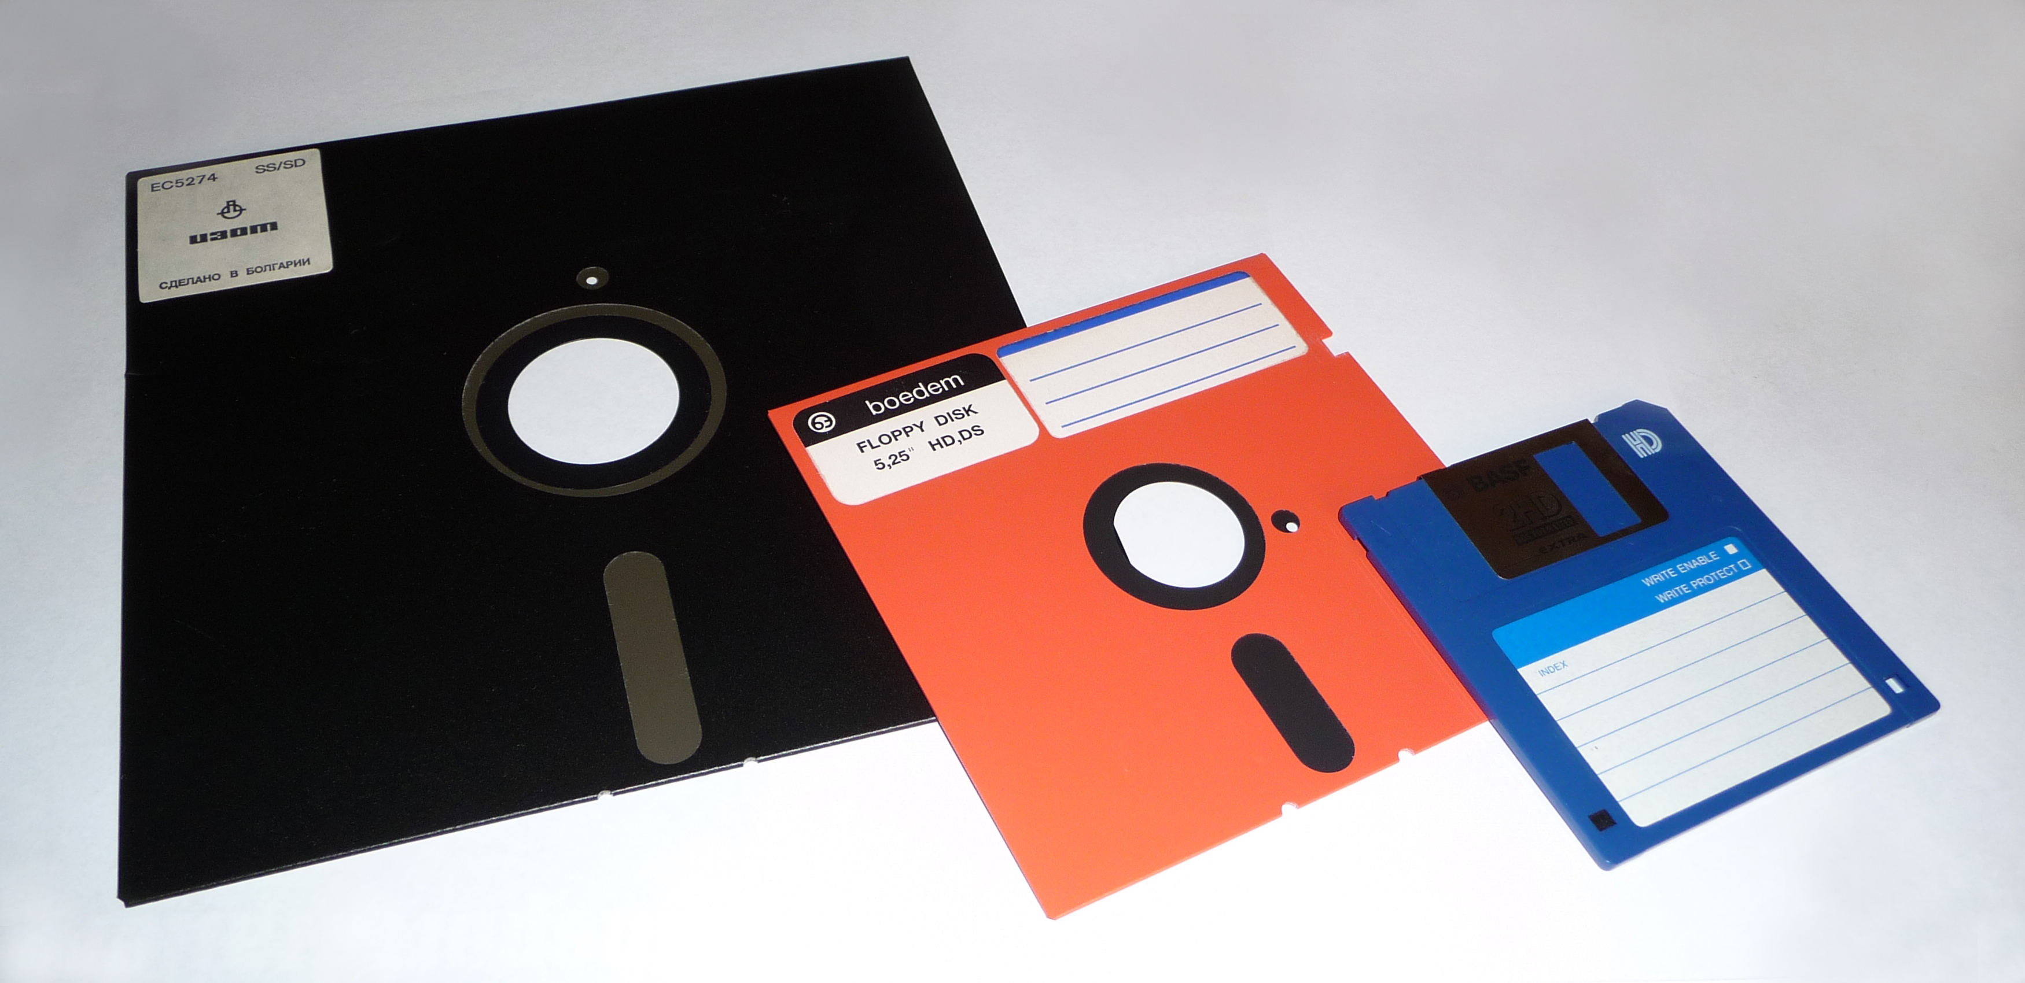
IBM PC (1981) (everything consolidated into one box except storage (floppy drives), monitor, and keyboard)
Data storage on “floppy”
disks, which were sold
separately; soon even they
became integrated in a “hard drive”
Storage capacity: original
Floppy: 80K; 1986: 3.5 inch
Diskette, 1.44M; today a
1 terabyte drive holds
1,000,000 megabytes; today
A 2T external drive can be
Purchased for around $75.
Processor speed, 1981: 4.77
Mzh; today 3GHZ is common;
Approximately 700 to 1 ratio

Slide 19
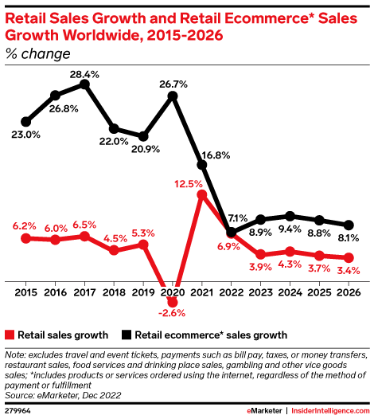
Disruption IV: Attack on Big Tech Worldwide Retail Growth: total vs. e-commerce
Difference is less dramatic in 2026 than in 2015,
but remains substantial.
Covid interruption favored e-commerce
Competition Policy should be targeting markets
that:
Exhibit little growth, with oligopoly behavior
Prone to price fixing
Lack of innovation

Slide 20
Competition Policy & Big Tech: IBM Repeated?
e-commerce growth much more rapid than old commerce growth
E-commerce prices are competitive or lower
Online entry barriers are lower than in traditional commerce (roughly 1m per year)
Big tech firms invest heavily in R&D
-- patent grants (2025): Apple #5, Alphabet #8; Microsoft #18; Amazon #20
-- research budgets (2022): Amazon #1, Alphabet #2, Meta #3, Apple #4, Microsoft #5 (all of the top five)
Online price comparisons are easier to make
Online consumer switching costs are lower
Digital “monopolies” experience more rapid turnover (e..g, G-Search and AI; Facebook and the “friends and family” market definition)
Digital markets are much more responsive to changes in relative position – e.g., Facebook’s market share exaggerates its power where users can turn on a dime.
In the USA, aggressiveness toward big tech operates as a kind of reverse industrial policy? Overregulation of digital in the EU follows the same path

Slide 21
Public Big Tech Antitrust Litigation: A U.S. Perspective
U.S. v. Microsoft (2001) (exclusionary licensing; restraints on innovation)
United States v. Meta(Facebook) (2026) (acquisition of Instagram) (dism’d)
United States v. Google: Search ($ for default) & AdTech (tying)
U.S. v. Amazon (MFN clauses limiting sellers’ ability to charge lower prices on other sites)
U.S. v. Apple (design features that favor or work only with Apple: e.g., iMessage, Apple Wallet)
AICOA (proposed): DMA-like Attempt at Aggressive Regulation of Digital Markets (EC gave DMA itself a clean bill, April 28, 2026)

Slide 22

THE END

Slide 23
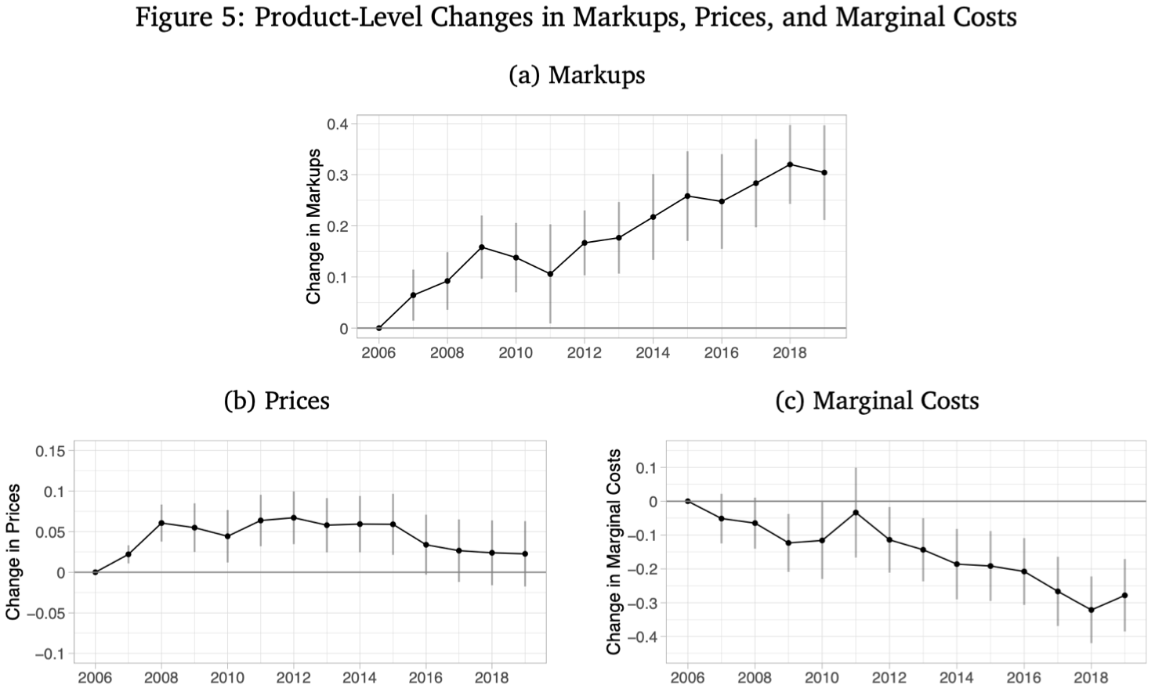
“Price” vs. “Market Power”* (falling costs increase market power -- both Progressive Era and today)
Dopper, MacKay, Miller,
Stiebale, Rising Markups
And the Role of Consumer
Preferences, 133 J.Pol.
Econ. 2462 (2025)
*As measured by
the Lerner Index,
As a function of
the relationship
Prices and
Marginal costs:
P-MC
P

