Slide 1
Competition law and Policy: 21st Century Challenges
Frederic Jenny
Professor Emeritus of Economics , ESSEC Business School, Paris
Fernand Braudel Fellow, European University Institute, Florence
MEET TO COMPETE-REPEAT, COMPETITION LAW AND POLICY CONFERENCE
Opatija, Croatia, May 13 -15 2026

Slide 2
Five Challenges for Competition Law and Policy in the 21st Century
The End of Globalization and International Trade Liberalization: Need to find a new perspective on competition
Competition and the Digital Markets: Need to adapt the competition law tools and analysis and to find new dynamic theories of harm
Competition and Sustainability: Need to reflect on the goals and time perspective of competition analysis
Competition and Innovation: Need to better understand the relationship between competition and innovation
Competition and Industrial Policy: Need to have a pro-industrial competition policy and a procompetitive industrial policy

Slide 3
1) A New World Trade Order

Slide 4
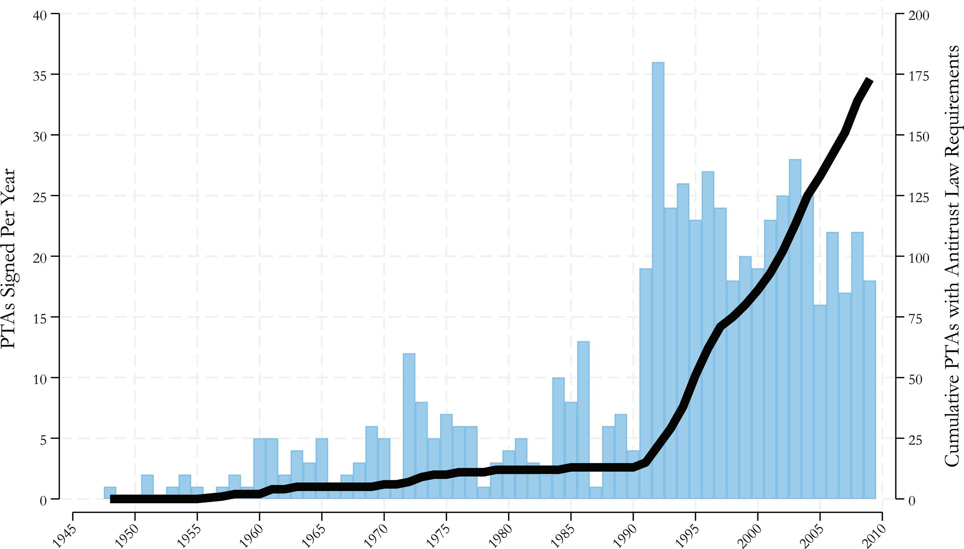
Trade Liberalization: Driver of the Adoption of Competition Policy and Law since the 1990s
The left-side y-axis (and vertical bars) (…) reports the number of Preferential Trade Agreements coded in our sample in each year, amounting to 596 unique PTAs in total. Of those PTAs, 160 were signed before 1990, illustrating the rapid rise in PTAs after 1990. The right-side y-axis (and solid line) (…) reports the number of PTAs in the sample that require countries to adopt antitrust laws. In total, 173 PTAs include requirements that countries adopt antitrust laws.'” However, only thirteen of those PTAs were signed before 1990. Such requirements began to appear in 1957 with the treaty establishing the European Community. However, these requirements became more common after 1990. By 2010, nearly thirty percent of PTAs included a requirement to adopt a domestic antitrust law. Some PTAs went even further, requiring each party to establish or maintain a distinct antitrust agency to enforce the law. These agency requirements became more common in the 1990s and, by 2010, appeared in ten percent of all PTAs in our sample.
Anu Bradford, Adam S. Chilton & Katerina Linos, The Limits and Promise o f Global Antitrust Law, 66 HARV.
INT'L L. J. 431 (2025). Available at: https://scholarship.law.coIumbia.edu/facuIty_schoIarship/4701

Slide 5
Decline in the Trust that Competitive Markets Delivers Positive Outcomes
1996 The Dot-Com bubble; markets can be irrational. ( cf the “exuberance” of markets , coined by Fed chair Alan Greenspan in a 1996 speech)
2001-2010 The admission of China in the WTO leads to commercial tensions Alleged unfairness of the Chinese Trade ( automobiles for example); lack of adjustment for the losers in the “competition game” in developed countries
2008 Financial and economic crisis
1) Competitive markets can fail/ Regulation may be a necessary complement to Competition Policy
2) In a global economy, a trading country’s economy may be affected by events in other countries ( ex in 2008 UK banks were exposed (directly or indirectly) to U.S. sub-prime mortgage markets or the securitised products built from them. The collapse of those loans in the U.S. triggered losses elsewhere and in particular in the UK banking sector) . Hence loss of resilience
2020 Covid pandemic
1) with Globalization, a domestic economy relies on a global value chains which can be affected by external events
2) Markets adjust slowly ( ex masks, respirators, etc…..) and hence government intervention may be justified when the lack of adjustment of supply and demand creates an externality
3) Cooperation between competitors may be useful to accelerate innovation
2022 Russia-Ukraine war
2026 US-Iran: Further disruptions of the global supply chains

Slide 6

Failure of Competition Law and Policy to Deliver Visible Macroeconomic Benefits
What explains the rebirth of protectionism in the West?
There are likely many factors behind it, but arguably the most prominent are the protracted weakness of Western economies eight years after the financial crisis; ongoing deindustrialisation across much of Europe and the United States; slower wage growth than the twentieth-century trend; heightened perceptions of income and wealth inequality within countries; and anxiety over technological and economic change at an ever faster pace.
Diego Zuluaga, Executive Director, Government Affairs at Goldman Sachs, “Public Opinion Is Turning Against Free Trade and Globalisation”,European Policy Information Center, 05.07.2016

Slide 7
Consequences on Competition of the End of the Globalization and Trade Liberalization Movements
Reduction in the intensity of international competition
Need for more lively domestic competition law enforcement and policies
Competition between nations replaces cooperation for mutual gains and interferes with competition between firms
New sources of concerns about the market economy: sustainability, strategic independence, resilience
- Lower support for the independence competition authorities

Slide 8
2) The Emergence of the Digital Sector

Slide 9
A Few Characteristics of Competition in the Digital Sector
A Number of important differences between competition in the digital sector and competition in (most) non-digital sectors
Competition through innovation rather than competition on price
Competition in the digital sector is a competition (on innovation) between platforms providing differentiated baskets of complementary services rather than a price competition between pipe-line firms providing similar products
Because of strong single side and cross side network effects quality of the offering of a platform may increase with its size and lead to tipping
Competing platforms can have different business models and can change their business model ( because they intervene on multi-sided markets)
Competition in the digital sector is a competition for the market rather than a competition in the market
Users are providers of a crucial input into the production process (data)

Slide 10
Competition For the Market Instead of Competition In the Market
Dominant platform can easily be overturned by an entrant or rival with better technology, higher quality, or a different business model.
Ex MySpace displaced by Facebook as the dominant social media platform.
With respect to Web browsers Netscape was crushed by Microsoft’s Internet Explorer which was eventually crushed by Google Chrome;
With respect to operating systems MS-DOS disappeared and was replaced by Windows
With respect to mobile operating systems Blackberry and Nokia lo disappeared and were replaced by Android and iOS
The Schumpeterian process of innovation is how competition occurs, particularly in technology markets through disruptive technological entry

Slide 11
The Emergence of a New Approach Centered on Dynamic Anticompetitive Strategies
Much of the existing legislative framework pre-dates modern digital markets and our experience has demonstrated particular challenges in applying this to these issues (CMA advice of the Digital Task Force to the UK Government).
“The market power assessment should not require a formal market definition exercise, which results in a binary judgement of whether firms fall inside or outside of the market. Such a rigid approach would fail to recognise the nuanced and interconnected nature of digital products and services and underemphasise the importance of dynamic competition” (CMA Advice of the Digital Task Force to the Government)
the analysis of competition authorities may therefore require not just relying on traditional enforcement tools but following a more dynamic approach to better understand how structural economic moats are (i) embedded in the firm’s business model, (ii) sustained over time by entrenchment, (iii) influenced by the market characteristics, (iv) the result of a superior product or technology or leading to anticompetitive conduct (J. Furman, 2019) (OECD Competition Committee“Monopolisation, Moat Building And Entrenchment Strategies, Background note, June 2024 OECD Roundtables on Moat Building and Entrenchement )

Slide 12
3) Competition and Sustainability

Slide 13
Sustainable Development
In broad terms, sustainable development refers to the ability of society to consume and use the available resources today without compromising the ability of future generations to meet their own needs. 1972,The Limits to Growth, published by the Club of Rome: “Our conclusions are: 1. If the present growth trends in world population, industrialization, pollution, food production, and resource depletion continue unchanged, the limits to growth on this planet will be reached sometime within the next one hundred years. The most probable result will be a rather sudden and uncontrollable decline in both population and industrial capacity. 2. It is possible to alter these growth trends and to establish a condition of ecological and economic stability that is sustainable far into the future. 1987:Our Common Future The Bruntland Report Published by the UN’s World Commission on Environment and Development (chaired by Gro Harlem Brundtland): “Many of the development paths of the industrialized nations are clearly unsustainable. And the development decisions of these countries, because of their great economic and political power, will have a profound effect upon the ability of all peoples to sustain human progress for generations to come.” 1988: Creation of the IPCC, as climate science became impossible to dismiss. Assessment Report: 1990, 1995,2001,2007, 2013–2014, 2021–2023

Slide 14
Competition and Sustainable Development
1) Competition can promote sustainability: we indeed find that greater exposure to environmental attitudes has a significant positive effect on the probability for a firm to innovate in the clean direction, and all the more so the higher the degree of product market competition (Environmental Preferences And Technological Choices: Is Market Competition Clean Or Dirty? Philippe Aghion, Roland Bénabou,Ralf Martin, Alexandra Roulet )
2) Competition can impair sustainability: Demand side market failure: unwillingness to pay for environmental or social costs unless all other consumers pay an equivalent amount, hyperbolic discounting, behavioural biases, lack of accessible and reliable information about future costs of unsustainable products.
Supply side market failure: “collective action problems” (or “coordination problems”); That fear of first-mover disadvantage may deprive the firm from the economy of scale or scope necessary to lower average fixed costs of the sustainable alternative to a manageable level (Competition Policy And Environmental Sustainability, ICC, 26 November, 2020, OECD Competition Committee)
3) Sustainability can be a cover for an anticompetitive agreement

Slide 15
Does Competition Law Stand in the Way of Sustainability ?
Imagine a company that wants to build a new production plant and decommission the older “dirty plant” to combat climate change. Given the significant investment this requires, the company may need to increase its prices and risks being at a competitive disadvantage vis-a-vis its competitors: a dilemma also described as the “first-mover disadvantage”.
To avoid this problem, the company agrees with its two main competitors that they will also modernize their respective plants.
From a sustainability point of view, such co-operation prima facie seems to be welcome. From the perspective of competition law enforcers, this type of co-operation rings alarm bells, and, as has been pointed out by Olivier Guersent, Director General for Competition at the EU Commission, among others, could constitute a prohibited cartel

Slide 16
Conclusion on Competition Law Enforcement and Sustainability
1) Regulation is in general a better instrument than competition law enforcement to deal with a market failure
(advocacy role of competition authorities)
2) Necessity for competition authorities to be transparent and to offer guidance on how they will deal with the issue of
of sustainability agreements
3) Public interest versus new concept of efficiency
4) Time frame of the competition analysis
5) Conditions for exemptions ( should out of market efficiencies be considered)
6) Necessity for competition authorities to be alert to possible greenwashing

Slide 17
4) Competition and innovation

Slide 18
Introduction to Competition and Innovation
Importance of understanding the relationship between competition and innovation for economic growth.
"Competition drives innovation and, in turn, innovation drives higher welfare and economic growth. However, there is no theoretical consensus on the precise relationship between these variables”
"Future research should focus on the implications of the relationship between competition and innovation in competition enforcement and policy adaptation.
Hearing on Competition and Innovation:Background note by the Secretariat, OECD 2023

Slide 19
Competition Law: the Need for a New Approach
Thomas Rosch, FTC Commissioner, 2010 “Antitrust has historically focused on static (rather) than dynamic analysis… for a number of reasons. First the antitrust community… both lawyer and economists… have far greater familiarity and comfort with static analysis rather than dynamic analysis. Third there’s a perception… that dynamic analysis is less well developed…”
Christine Wilson, FTC Commissioner, Sept 11, 2019 “Innovation over the longer run will deliver very large consumer welfare gains” yet competition authorities “routinely struggle to account for dynamic effects”
UK Competition Apple’s Tribunal in Meta v CMA 2022” “Identifying the criteria that are relevant in determining whether a state of dynamic competition exists, and if so, whether a merger weakens that competition, is extremely difficult.”
David J. Teece, M&A and Digital: A More Dynamic Approach? Concurrences Round Table November 14, 2022

Slide 20
Kerber/ Teece : toward a dynamic perspective on competition
The second main thesis of this paper is that our current assessment concepts for the application of competition law are not sufficiently capable for dealing with innovation, partly due to the dominance of static concepts. Therefore, much more innovation-specific assessment concepts and methods are needed that fit better to the dynamic and innovative character of competition processes.
We will discuss this issue, using, inter alia, the example of innovation-specific concepts for identifying innovation competitors (market definition).
This will place the analysis of knowledge, capabilities, and necessary resources for innovation into the main focus of assessments
Towards a dynamic concept of competition that includes innovation by Wolfgang Kerber (University of Marburg),

Slide 21
Conclusion on Competition and Innovation
Need to include innovation as an element of performance in competition analysis
Need to move from a static competition analysis to a dynamic analysis ( recognizing that competition drives innovation as innovation drives competition in redefining markets)
3) Need to allow for a longer time perspective in competition law enforcement
4) Need to have a more coherent and pragmatic economic framework on the relationship between competition and innovation ( and need to move from an exclusive focus on the role of incentives to a consideration of capabilities)
5) Need to adapt the standard of proof in competition law enforcement ( asymetry of treatment between competition restrictions and efficiency benefits ( whether static or dynamic ) in some jurisdictions)
6) Need to consider the complementarities between different policies in the promotion of innovation ( and possible trade-offs)

Slide 22
5) Revival of Industrial Policy

Slide 23
Trends: Revival of Industrial Policy
Industrial policy is on the rise:
increase in the total count of industrial policy interventions through the 2010s, with major accelerations in 2018 and 2021. The continuing decline in the employment shares of manufacturing in the USA and Western European countries and the increasing competitive threat posed by China on world markets have pushed in the same direction; industrial policy is being further stimulated by disruptive technological change—from automatization to digitalization, industry 4.0, and the Internet of things
This is a trend that is paralleled to some extent in other nations. In Germany, for example, there have been calls for more activist industrial policies both from left leaning economists like Peter Bofinger and from the conservative minister for industry Peter Altmaier. France and Germany tried to reestablish their cooperation in the EU by publishing a “Manifesto” on industrial policy.

Slide 24
New Industrial Policy and Competition Policy
The actual practice of industrial policy looks quite different from the way economists have traditionally conceptualized it. It entails dynamic, iterative collaboration between the government and firms in the pursuit of a more diffuse set of goals.
Correcting market failures, whether they be static (monopoly, provision of public goods) or dynamic (path dependency, neglect of the distant future and lack of international cooperation) is important, but the goals of industrial policy are wider,including market shaping, mission orientation, and providing new basic technologies.
industrial policy can no longer be an isolated policy, developed on its own and competing with competition, regional, and other growth policies (Aiginger 2014).
An increased focus on societal and environmental goals is necessarily raising questions about industrial policy as it shapes the structure of economic activity more generally. Societal goals involve climate, health, poverty prevention, good-job creation, and the reduction of inequality.

Slide 25
Interaction between competition and industrial policy
Instruments
Mechanisms
Goals
Competition policy and law
Competition law enforcement
Advocacy
Promote, maintain competition
Promote Growth
Sustainability
Innovation
Resilience
Strategic indep;
Correct market failures
(Externalities,
Coordination failures)
Create non existent
markets
Industrial policy
Custom duties
Subsidies
Public procurement
Tax exemptions

Slide 26
Conclusions
Common themes for competition authorities
Need to adopt a longer time frame for the competition and efficiency analysis
Need to recognize the importance of assessing non price effects of practices and transactions
3) Need to move from a static to a dynamic perspective on competition and innovation
4) Need to revise our competition law enforcement toolbox ( including international cooperation)
5) Need to coordinate competition policy with other economic policies

Slide 27

Competition authorities will just keep crashing if they never take their eyes off the rear view mirror

