Slide 1
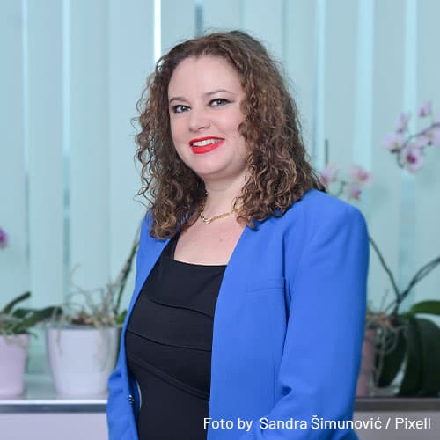
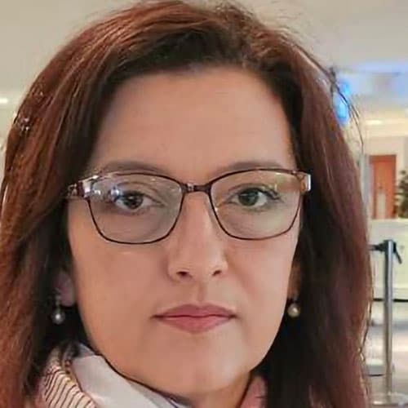
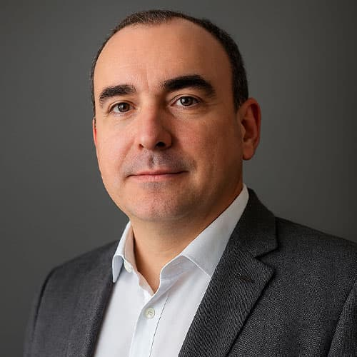
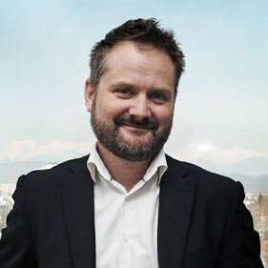


Meet to Compete - Repeat
Opatija | May 2026
Regional Enforcers Roundtable
SPEAKERS
PHOTO
PHOTO
PHOTO
PHOTO
Mirta Kapural
Valentina Nikolova
Vanja Malidžan
Andrej Matvoz
President of the Competition Council of Competition Agency in Croatia
Head of MC Dept., Competition Commission of North Macedonia
Member of the Competition Council
of Bosnia and Herzegovina
Director of Competition
Protection Agency in Slovenia
MODERATOR
PHOTO
Srđana Petronijević
Partner at Schoenherr Law Firm, CEE region

Slide 2
Topics for Discussion
1
From Watchdogs to Super-Authorities: How Far Should Competition Commissions Go?
2
Accessible Authorities: Transparency, Competition Advocacy and Market Dialogue
3
What Comes Next: Enforcement Trends, Legislative Priorities and EU Influence
Regional Enforcers Roundtable | Meet to Compete - Repeat | Opatija, May 2026

Slide 3
Topic 1: From Watchdogs to Super-Authorities: How Far Should Competition Commissions Go?
Regional Enforcers Roundtable | Meet to Compete - Repeat | Opatija, May 2026

Slide 4
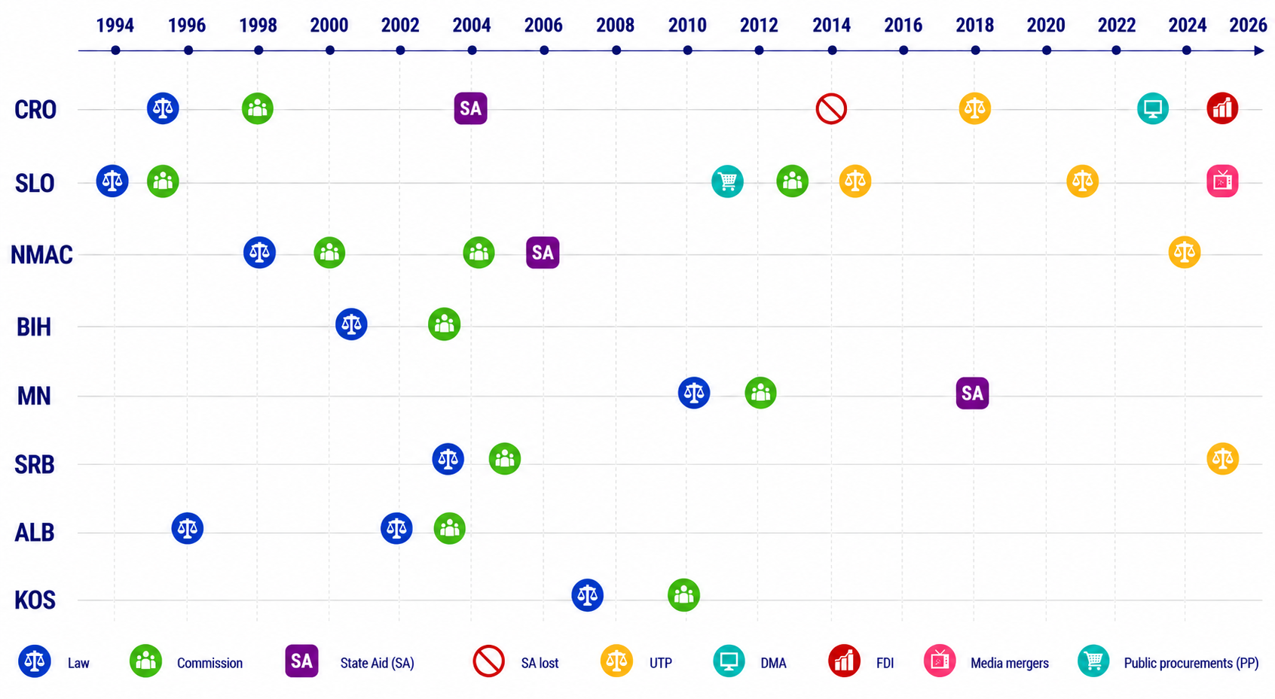
Developments in Regional Competition Authorities’ Competences
Regional Enforcers Roundtable | Meet to Compete - Repeat | Opatija, May 2026

Slide 5
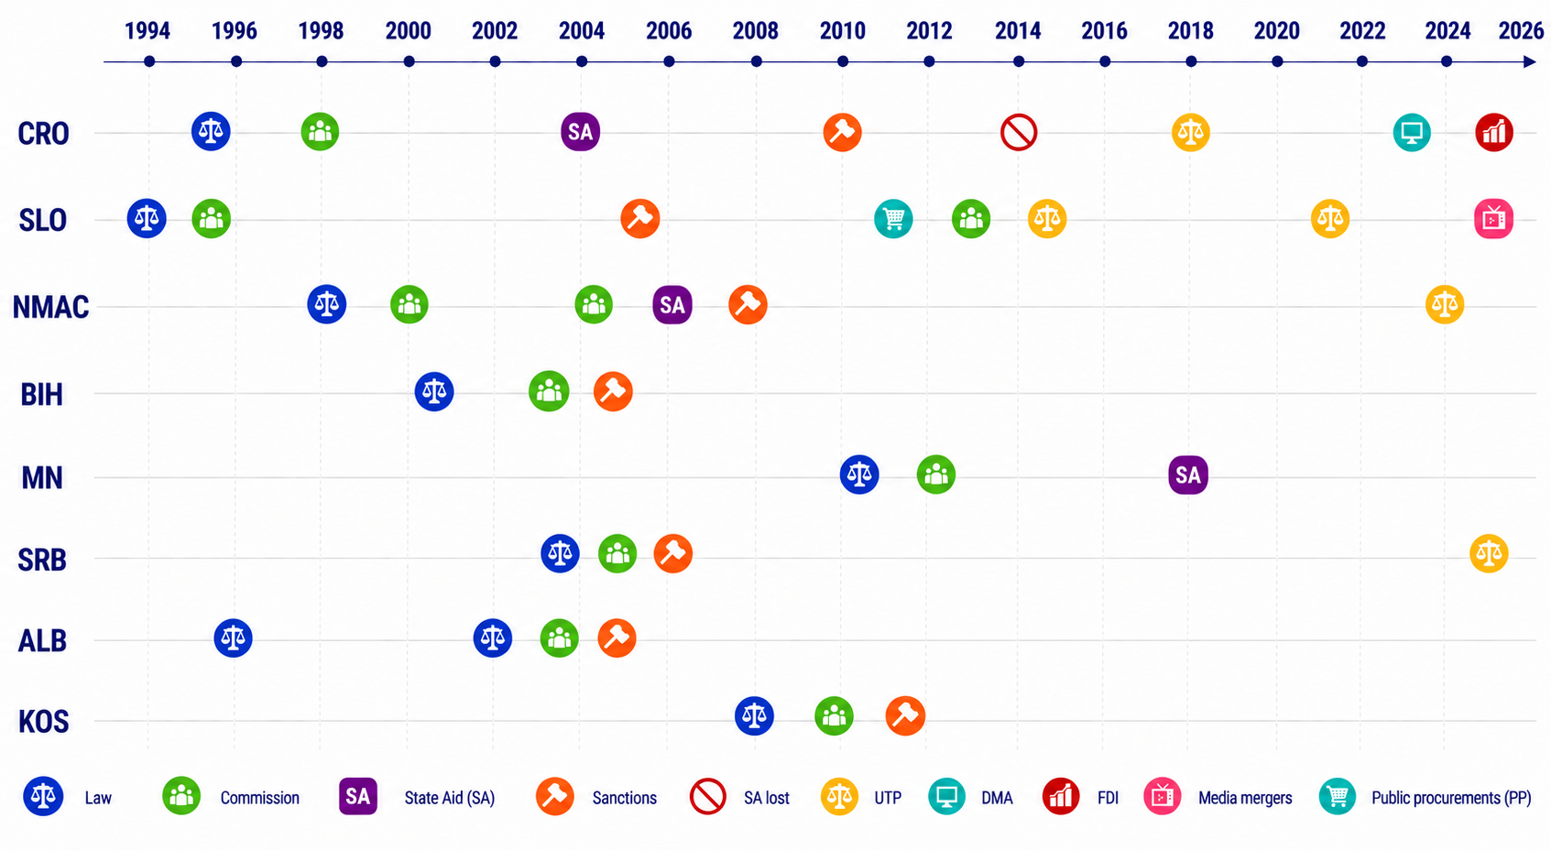
Developments in Regional Competition Authorities’ Competences
Regional Enforcers Roundtable | Meet to Compete - Repeat | Opatija, May 2026

Slide 6
Topic 2: Accessible Authorities: Transparency, Competition Advocacy and Market Dialogue
Regional Enforcers Roundtable | Meet to Compete - Repeat | Opatija, May 2026

Slide 7
Topic 3: What Comes Next: Enforcement Trends, Legislative Priorities and EU Influence
Regional Enforcers Roundtable | Meet to Compete - Repeat | Opatija, May 2026

Slide 8
Chapter 8: Reform Priorities for Candidate Countries
Category | NMAC | BIH | ALB | MN | SRB | KOS
LEGAL
Legislative alignment with EU acquis | X | X | X | X | X | X
Align existing aid schemes with EU/SAA |  | X |  |  | X
INSTITUTIONAL
Remove institutional obstacles |  | X
Independence of authorities |  | X | X |  |  | X
Administrative/financial capacity | X |  | X | X |  | X
Judicial capacity | X |  |  | X
ENFORCEMENT
Enforcement / track record |  | X | X | X | X | X
Transparency | X | X | X |  | X
Regional Enforcers Roundtable | Meet to Compete - Repeat | Opatija, May 2026

Slide 9
Chapter 8: Reform Priorities for Candidate Countries
Category | NMAC | BIH | ALB | MN | SRB | KOS
LEGAL
Legislative alignment with EU acquis | X | X | X | X | X | X
Align existing aid schemes with EU/SAA |  | X |  |  | X
INSTITUTIONAL
Remove institutional obstacles |  | X
Independence of authorities |  | X | X |  |  | X
Administrative/financial capacity | X |  | X | X |  | X
Judicial capacity | X |  |  | X
ENFORCEMENT
Enforcement / track record |  | X | X | X | X | X
Transparency | X | X | X |  | X
Regional Enforcers Roundtable | Meet to Compete - Repeat | Opatija, May 2026

Slide 10
Chapter 8: Reform Priorities for Candidate Countries
Category | NMAC | BIH | ALB | MN | SRB | KOS
LEGAL
Legislative alignment with EU acquis | X | X | X | X | X | X
Align existing aid schemes with EU/SAA |  | X |  |  | X
INSTITUTIONAL
Remove institutional obstacles |  | X
Independence of authorities |  | X | X |  |  | X
Administrative/financial capacity | X |  | X | X |  | X
Judicial capacity |  |  |  | X
ENFORCEMENT
Enforcement / track record |  | X | X | X | X | X
Transparency | X | X | X |  | X
Regional Enforcers Roundtable | Meet to Compete - Repeat | Opatija, May 2026

Slide 11
Chapter 8: Key Reform Priorities for Candidate Countries
Category | NMAC | BIH | ALB | MN | SRB | KOS
LEGAL
Legislative alignment with EU acquis | X | X | X | X | X | X
Align existing aid schemes with EU/SAA |  | X |  |  | X
INSTITUTIONAL
Remove institutional obstacles |  | X
Independence of authorities |  | X | X |  |  | X
Administrative/financial capacity | X |  | X | X |  | X
Judicial capacity | X |  |  | X
ENFORCEMENT
Enforcement / track record |  | X | X | X | X | X
Transparency | X | X | X |  | X
Regional Enforcers Roundtable | Meet to Compete - Repeat | Opatija, May 2026

Slide 12
Thank You
Regional Enforcers Roundtable
Meet to Compete - Repeat | Opatija, May 2026

